Slide 2
I am so tired I’m just seeing text and the presenters voice Is monotonous. I am not stimulated at all by this presentation. What was that he just said. Oh goodness, the slide has too much text on it. I wonder how long this presentation is going to be still? I am so tired I’m just seeing text and the presenters voice Is monotonous. I am not stimulated at all by this presentation. What was that he just said. Oh goodness, the slide has too much text on it. I wonder how long this presentation is going to be still? I am so tired I’m just seeing text and the presenters voice Is monotonous. I am not stimulated at all by this presentation. What was that he just said. Oh goodness, the slide has too much text on it. I wonder how long this presentation is going to be still? I WONDER WHAT IS FOR LUNCH? I am so tired I’m just seeing text and the presenters voice Is monotonous. I am not stimulated at all by this presentation. What was that he just said. Oh goodness, the slide has too much text on it. I wonder how long this presentation is going to be still?

Slide 3
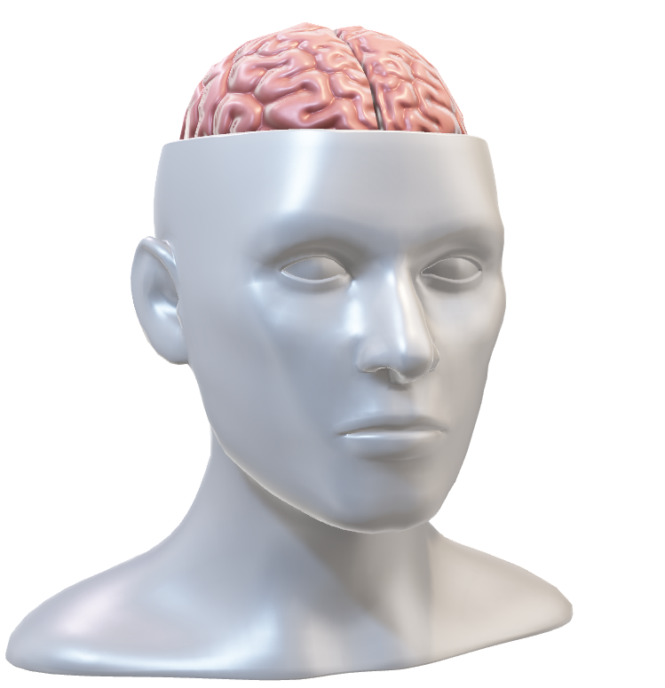
I am so tired I’m just seeing text and the presenters voice Is monotonous. I am not stimulated at all by this presentation. What was that he just said. Oh goodness, the slide has too much text on it. I wonder how long this presentation is going to be still? I am so tired I’m just seeing text and the presenters voice Is monotonous. I am not said. Oh goodness, the slide has the slide has too much text on it. I wonder how long this presentation is going to be still?
VERBAL NARRATIVE
VISUAL PASSAGE

Slide 4
I am so tired I’m just seeing text and the presenters voice Is monotonous. I am not stimulated at all by this presentation. What was that he just said. Oh goodness, the slide has too much text on it. I wonder how long this presentation is going to be still? I am so tired I’m just seeing text and the presenters voice Is monotonous. I am not said. Oh goodness, the slide has the slide has too much text on it. I wonder how long this presentation is going to be still?
VERBAL NARRATIVE
Visual
Input
Retina
Brain
Shape Color Orientation

Slide 5
The use of bullet lists
Lots of text on slides
Graphs which contain complex analysis
ClipArt, sounds, and Animations which detract

Slide 6


Slide 7
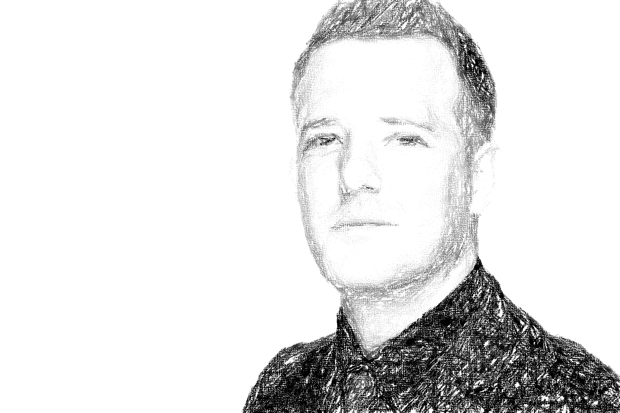

Slide 9
Title Ipsum Dolor sit
POOR USE OF COLOR
GOOD USE OF COLOR
POOR USE
OF COLOR
GOOD USE
OF COLOR
POOR USE
OF COLOR
GOOD USE
OF COLOR
POOR USE
OF COLOR
GOOD USE
OF COLOR

Slide 11
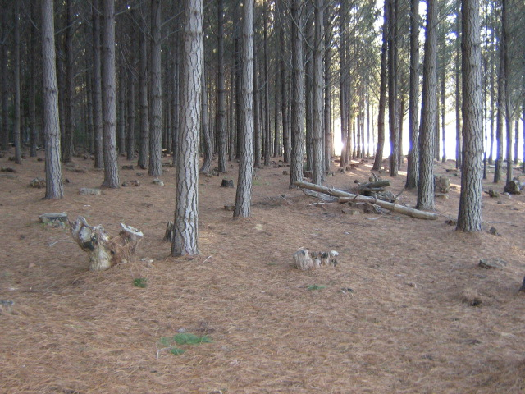
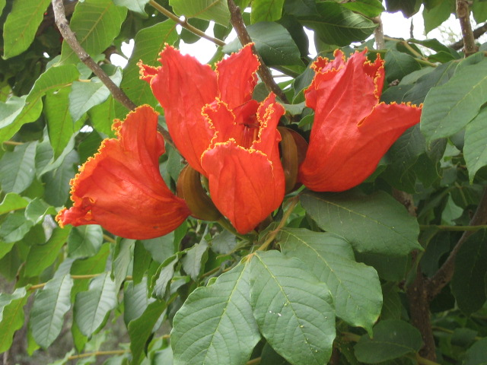
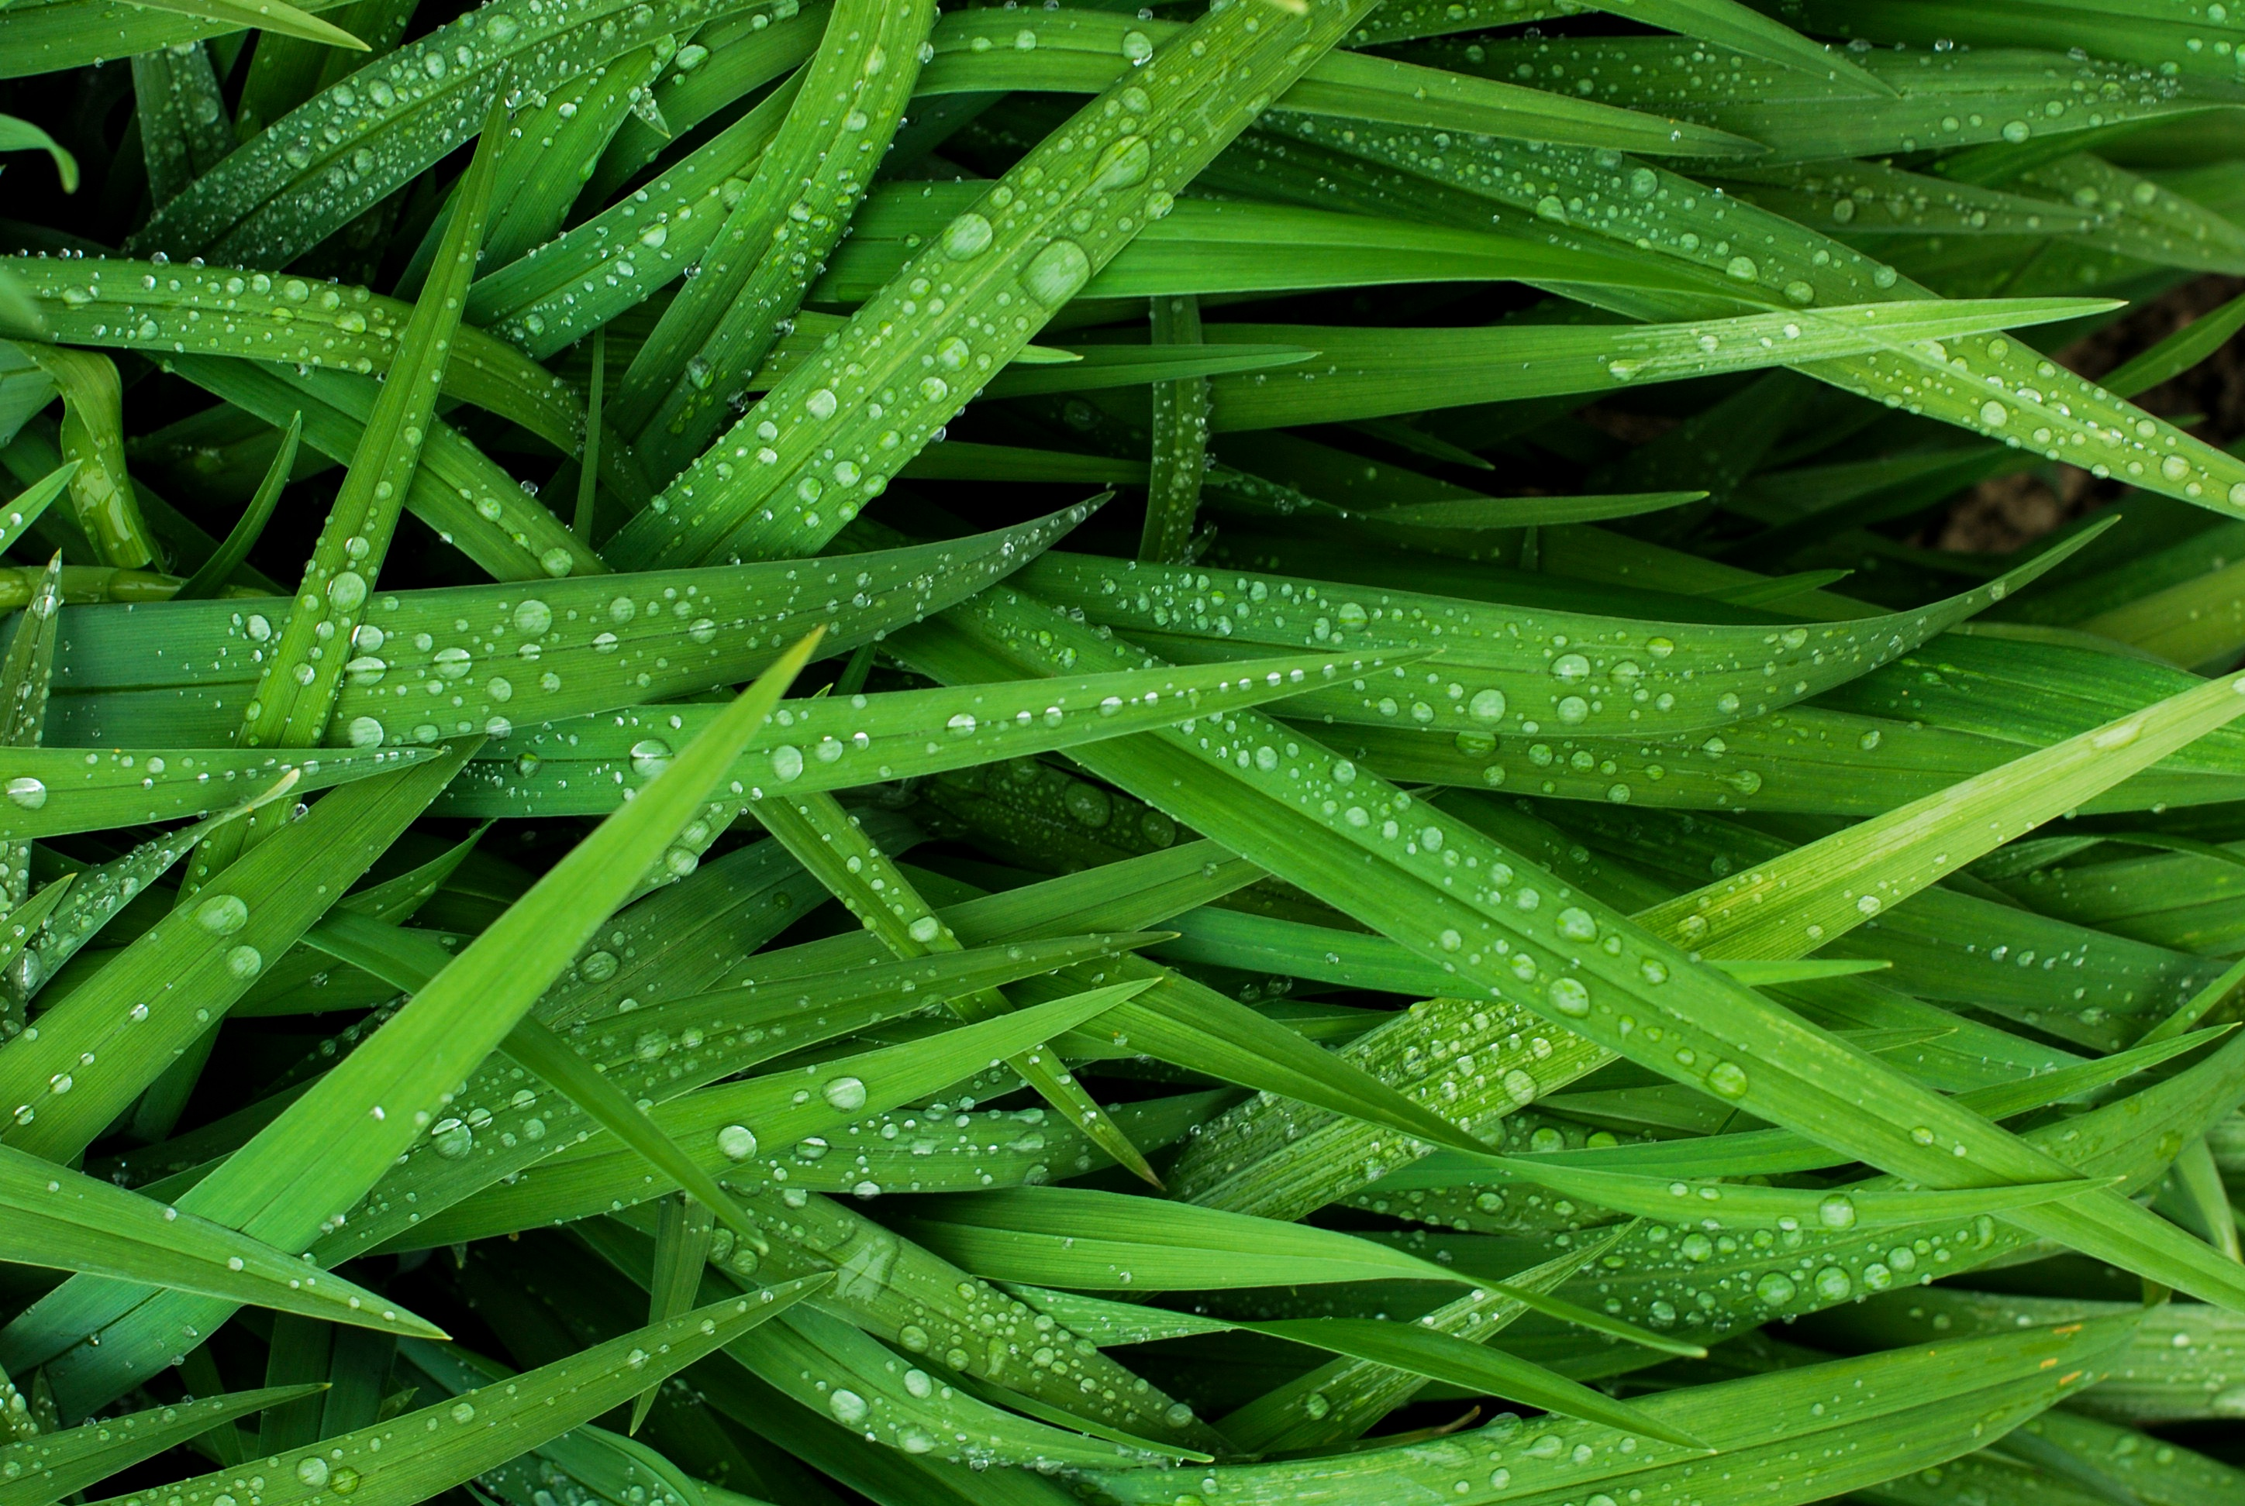
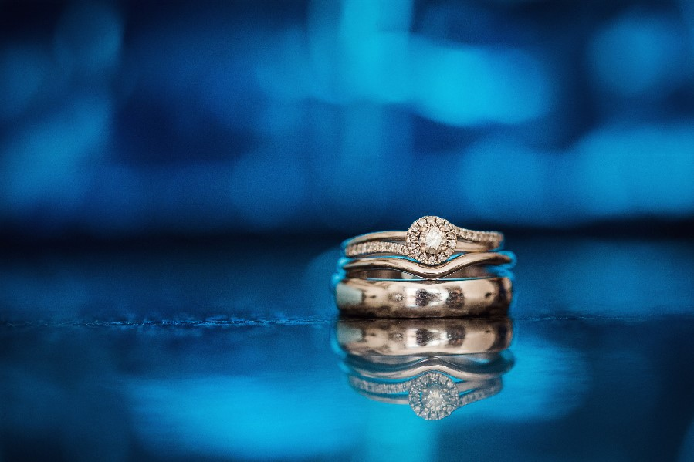
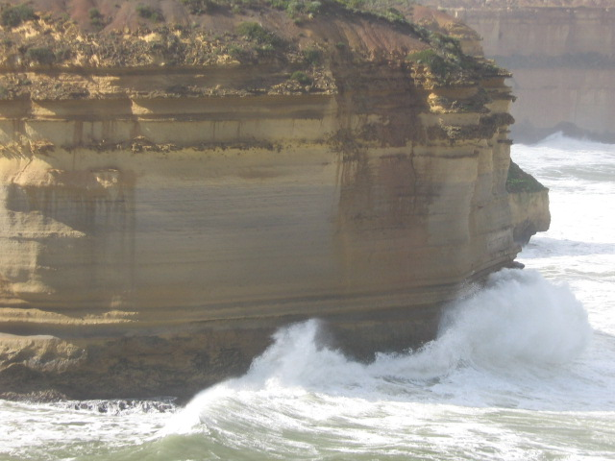


Slide 13
blue
orange
green
blue
orange
green

Slide 15
Text of Common Region
These elements are perceived as one object as it is surround by a border grouping the text together

